Slide 1

Book Recommendation
A look into using unsupervised ML techniques

Slide 2

Overview
Problem statement
Dataset
Discovery
Modeling
Conclusion

Slide 3

Problem statement
online bookstores and reading platforms have become increasingly popular
can be challenging for readers to find books that match their interests and preferences
Unsupervised learning focuses on discovering patterns and structures in data
Goal is to use an unsupervised learning model to produce book recommendations

Slide 4

Dataset
Dataset found on Kaggle website - https://www.kaggle.com/datasets/zygmunt/goodbooks-10k?datasetId=1938
Contains multiple csv files. Utilized 4 csv files for Discovery
Files contain list of books, their ratings, tags, userids and more

Slide 5

Cleaning the dataset
Had to drop null values on the books.csv files
No null values on the other csv files
Dropped duplicate values on the books.csv and ratings.csv files
No duplicate values on the other files

Slide 6
Exploratory Data analysis
Identified top 10 books by number of ratings
Identified top 10 books by highest average rating
Plotted frequency of average ratings
Identified tags as possible source for ‘genres’

Slide 7
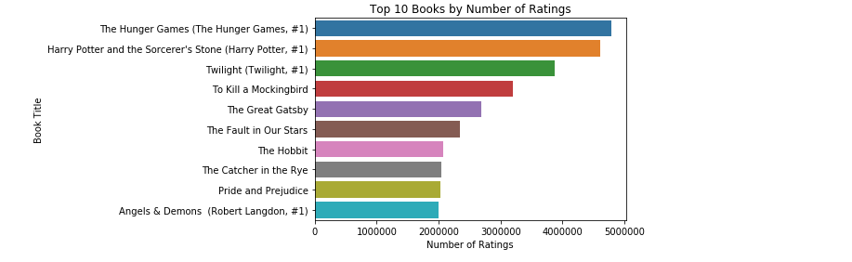
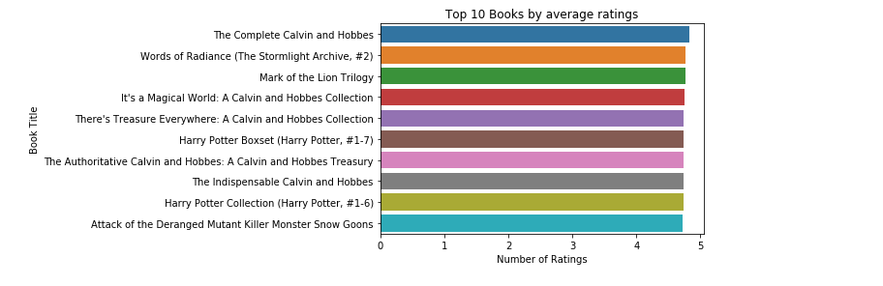

Slide 8
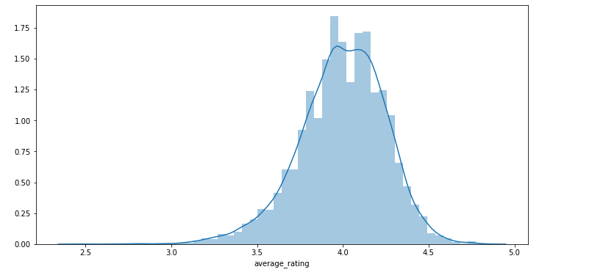
Avg Rating of the books

Slide 9

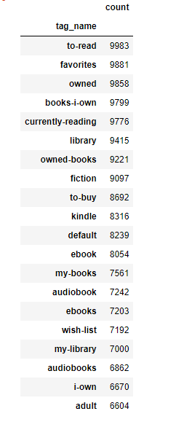
Tags
Too many tags (about 34252)
Too much work to find genres from these tags

Slide 10

Key discoveries
There are a lot of ratings on the top 10 books(with regards to the count)
Most of the books are rated from 3.5 to 4.5 out of a rating of 5
Might be too much work to identify genres from the tags
Might be easier to make the recommendation model based of ratings rather than genre. For now…

Slide 11

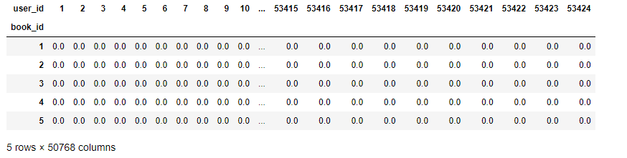
Knn Model
Merge books and ratings csv together
Pivot the table to get a user-item matrix
Used csr_matrix on the pivoted table to get a sparse matrix
Created a NearestNeighbors model and fit the sparse matrix into the model

Slide 12
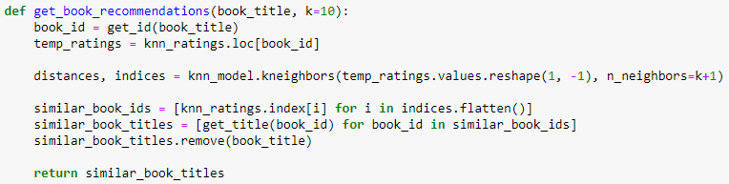
Code

Slide 13
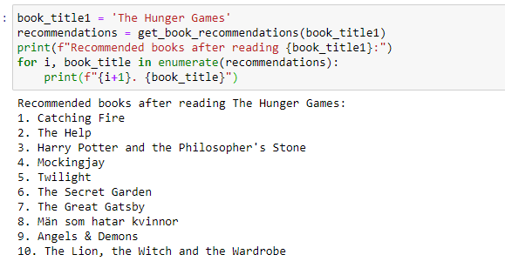
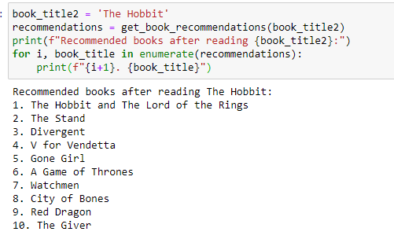
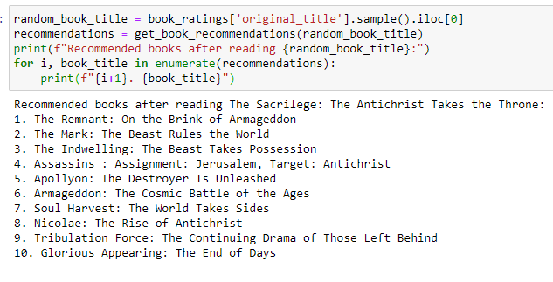
Outputs

Slide 14

Conclusion
Able to successfully retrieve recommendations from a book title
Books were identified based on similar rating patterns
Unable to implement a test to validate the accuracy and effectiveness of model
Overall, the model and recommendation function have the potential to be useful tools

Slide 15

SOURCES
WEBSITES
Dataset - https://www.kaggle.com/datasets/zygmunt/goodbooks-10k?datasetId=1938.
Nearest Neighbors – https://scikitlearn.org/stable/modules/generated/sklearn.neighbors.NearestNeighbors.html
csr matrix - https://docs.scipy.org/doc/scipy/reference/generated/scipy.sparse.csr_matrix.html
Book recommendation system - https://www.analyticsvidhya.com/blog/2021/06/build-book-recommendation-system-unsupervised-learning-project/
Github – https://github.com/pramodhgopal/Book-recommendation

